Slide 2
Typography
Duration: 45 mins
Session by: Ganesh Gholap, Nargis Jamadar

Slide 3
At the end of this lesson:
Typography
Know the basics of typography
Create the typography for design system
Learn to use typography effectively in UI

Slide 4
Introduction

Slide 5

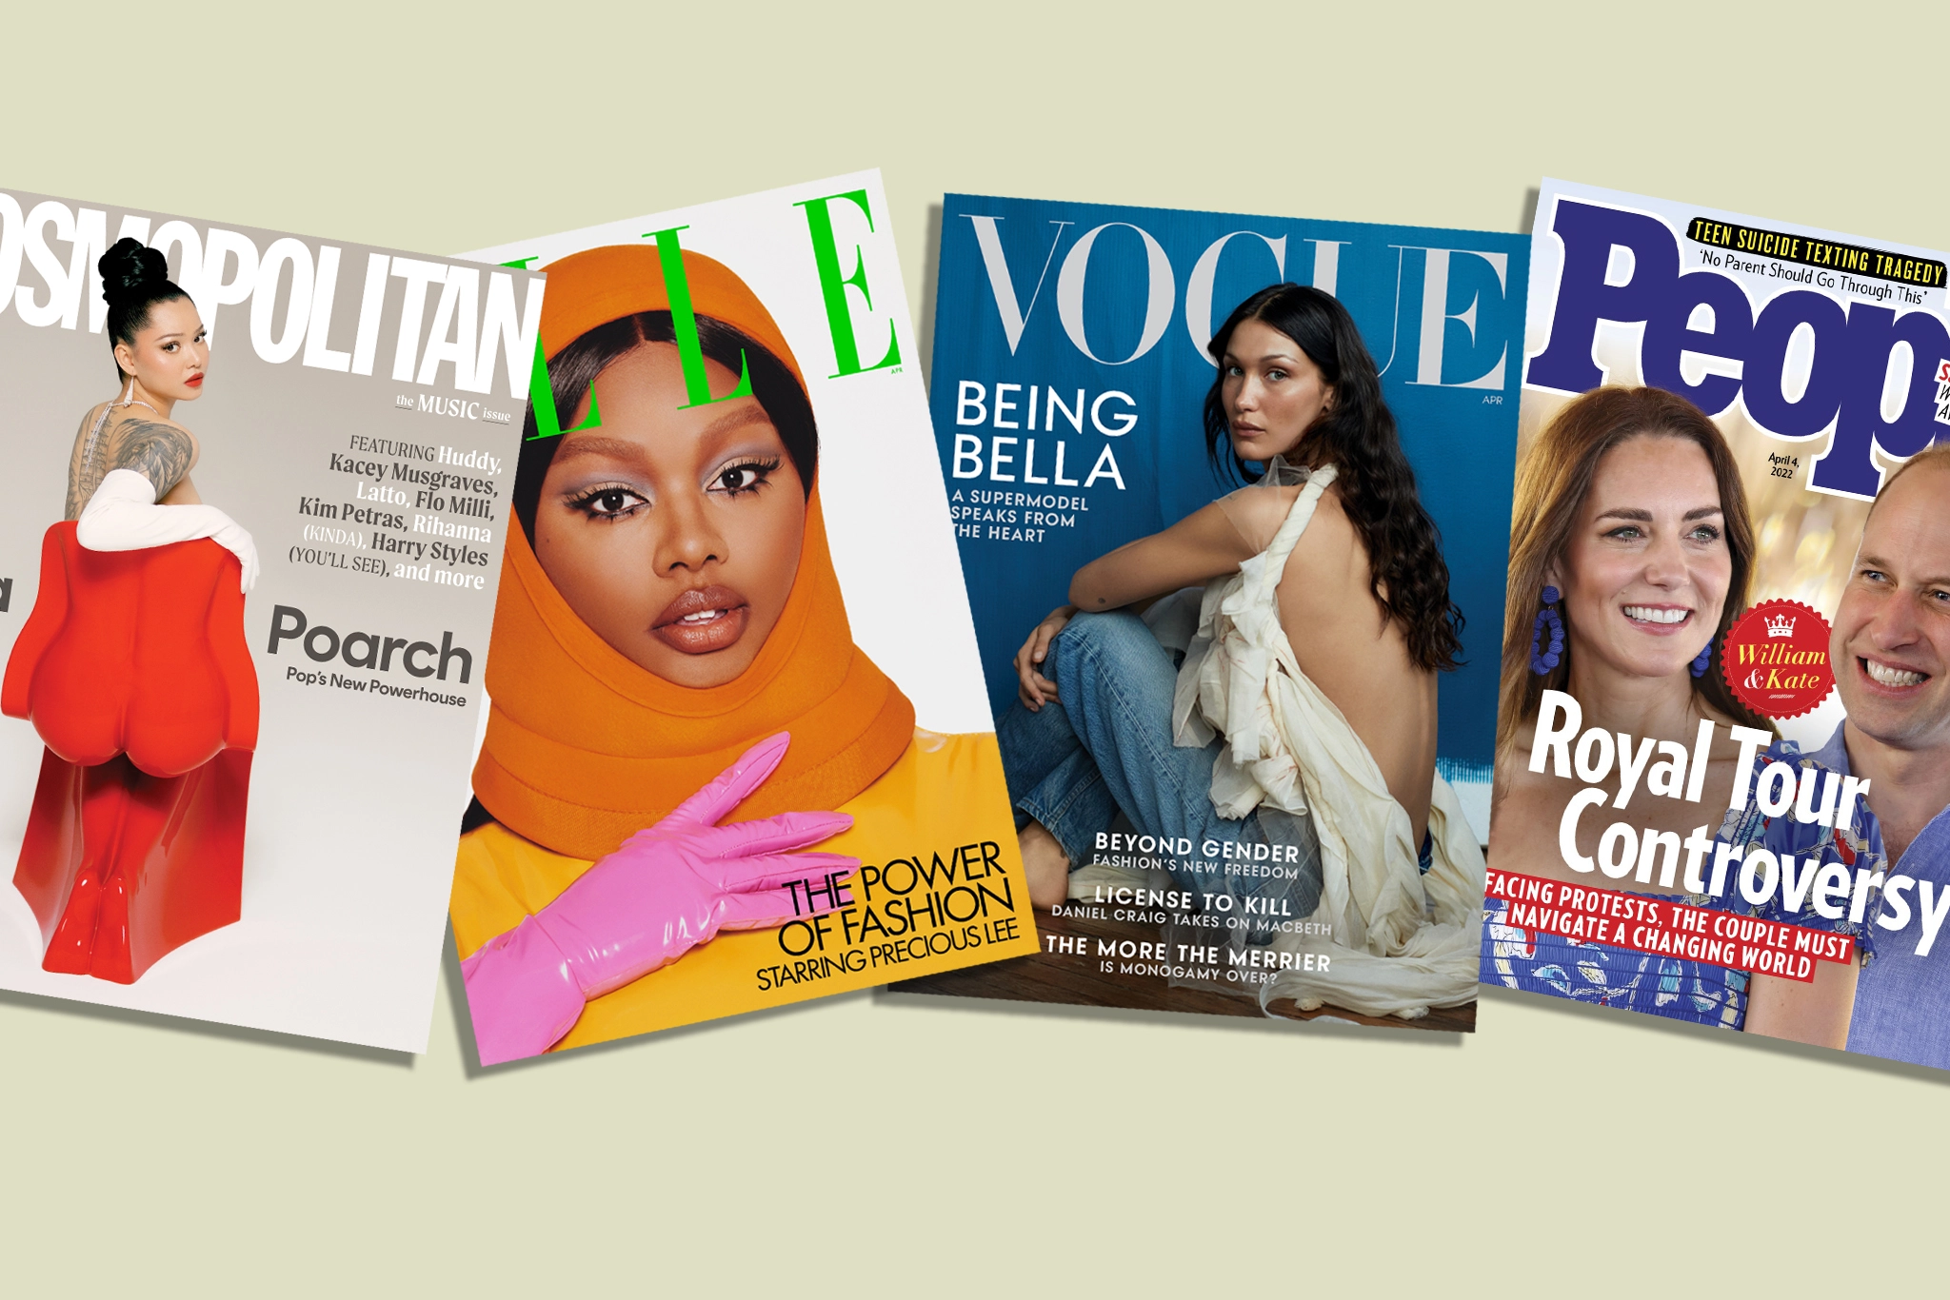
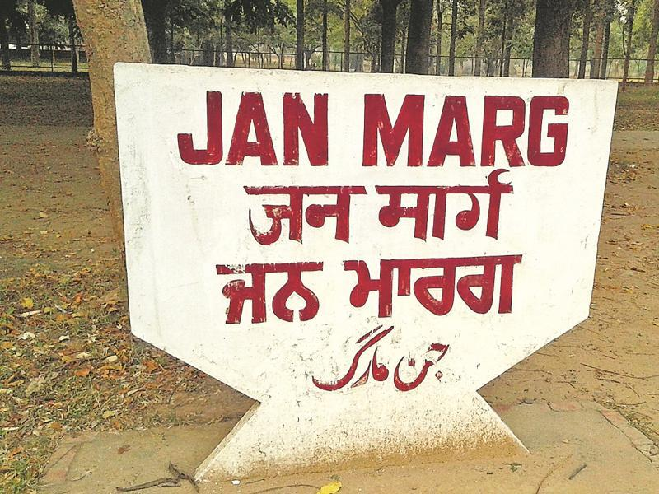
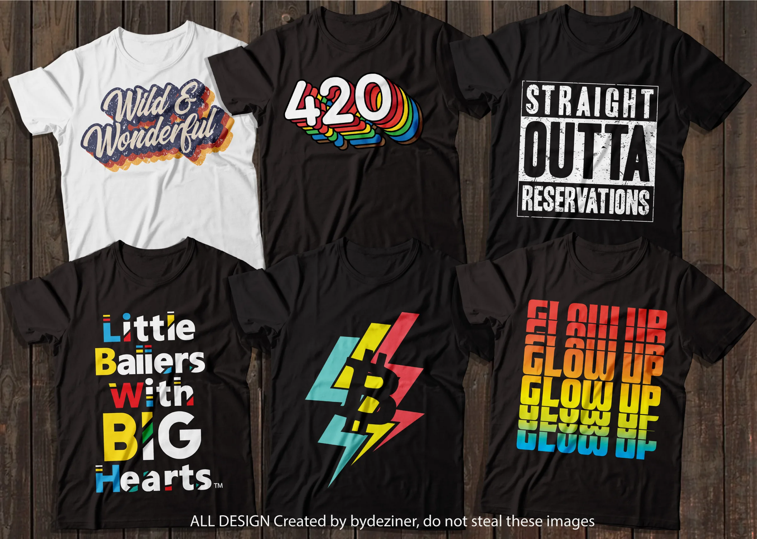
Typography
Typography in every day life
www.independent.co.uk
https://wwd.com/business-news/media/
https://www.hindustantimes.com/
https://www.himsale.com/?category_id=1855872
Notes:
Interaction with the audience: Presenter can ask the audience about the examples that they find in everyday life and how does that matter to them.
Everyday we’re greeted with an array of messages that scream for our attention.
From street signs to menu boards, typography and typographic letterforms are the common ingredients for communication. Yet, how often does one stop to analyze these symbols?

Slide 6
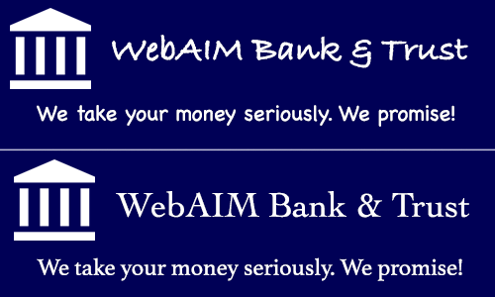
Typography
Which of these banks would you trust more with your money?
1
2
https://webaim.org/techniques/fonts/
Notes:
Giving the example how typography affects the overall look and feel and also the decision making.
Ask the audience which one is a better option for the bank. Option 2 is better; thus the font styling has a specific character to define. That’s why typography is an important aspect of the design.

Slide 7
Typography
What is typography?
Typography is the decision we make with how type is applied to written language—no matter what the typeface is—to offer a comfortable reading experience and a stylistic expression.
Notes:
Typography is the practice of making informed decisions about the setting of type.

Slide 8
Typography
Basics of typography

Slide 9
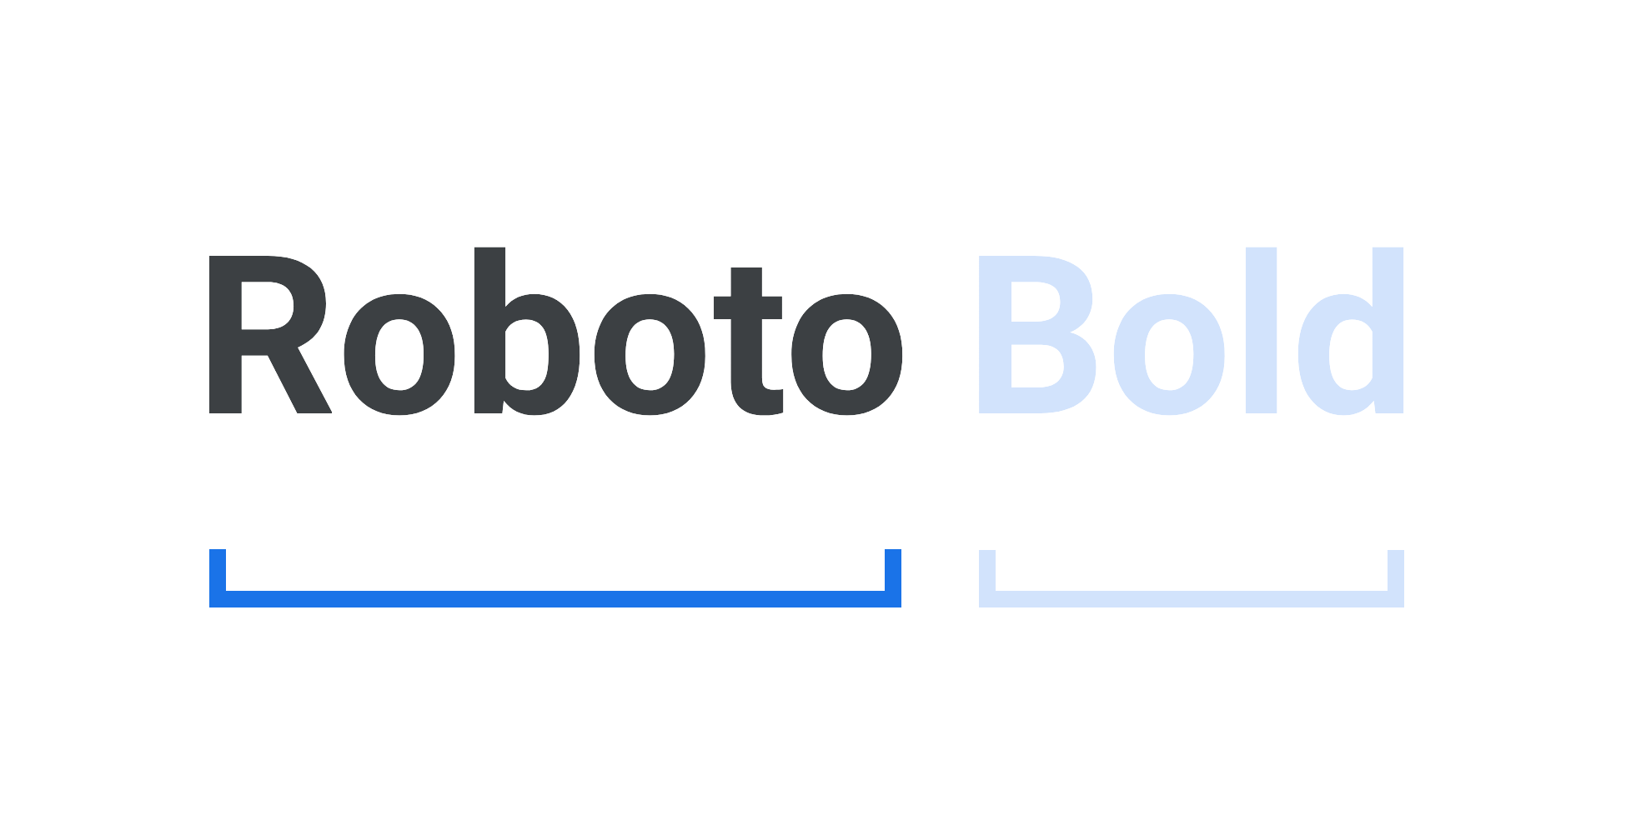
Typography
Typeface and font
A typeface is the underlying visual design that can exist in many different typesetting technologies, and a font is one of these implementations. In other words, a typeface is what you see and a font is what you use.
https://fonts.google.com/knowledge/glossary/typeface
Notes:
The main difference between these two terms is that a typeface (or type family) is the name of a specific collection of related fonts. In comparison, font refers to a particular weight, width, and style within that typeface. To put it in simple terms, each variation of a typeface is a font. For example, Helvetica would be the typeface chosen for a project, but the actual font in use might be Helvetica Regular 9 points.
In other words
A font is a computer file, software or program that instructs your computer to display and print each letter in a particular way. The font includes precise details like the weight, style (bold/italic) and point size.
A typeface is a set of letters, numbers and symbols (like glyphs) that have a common design ethos. A typeface refers to the whole family.

Slide 10
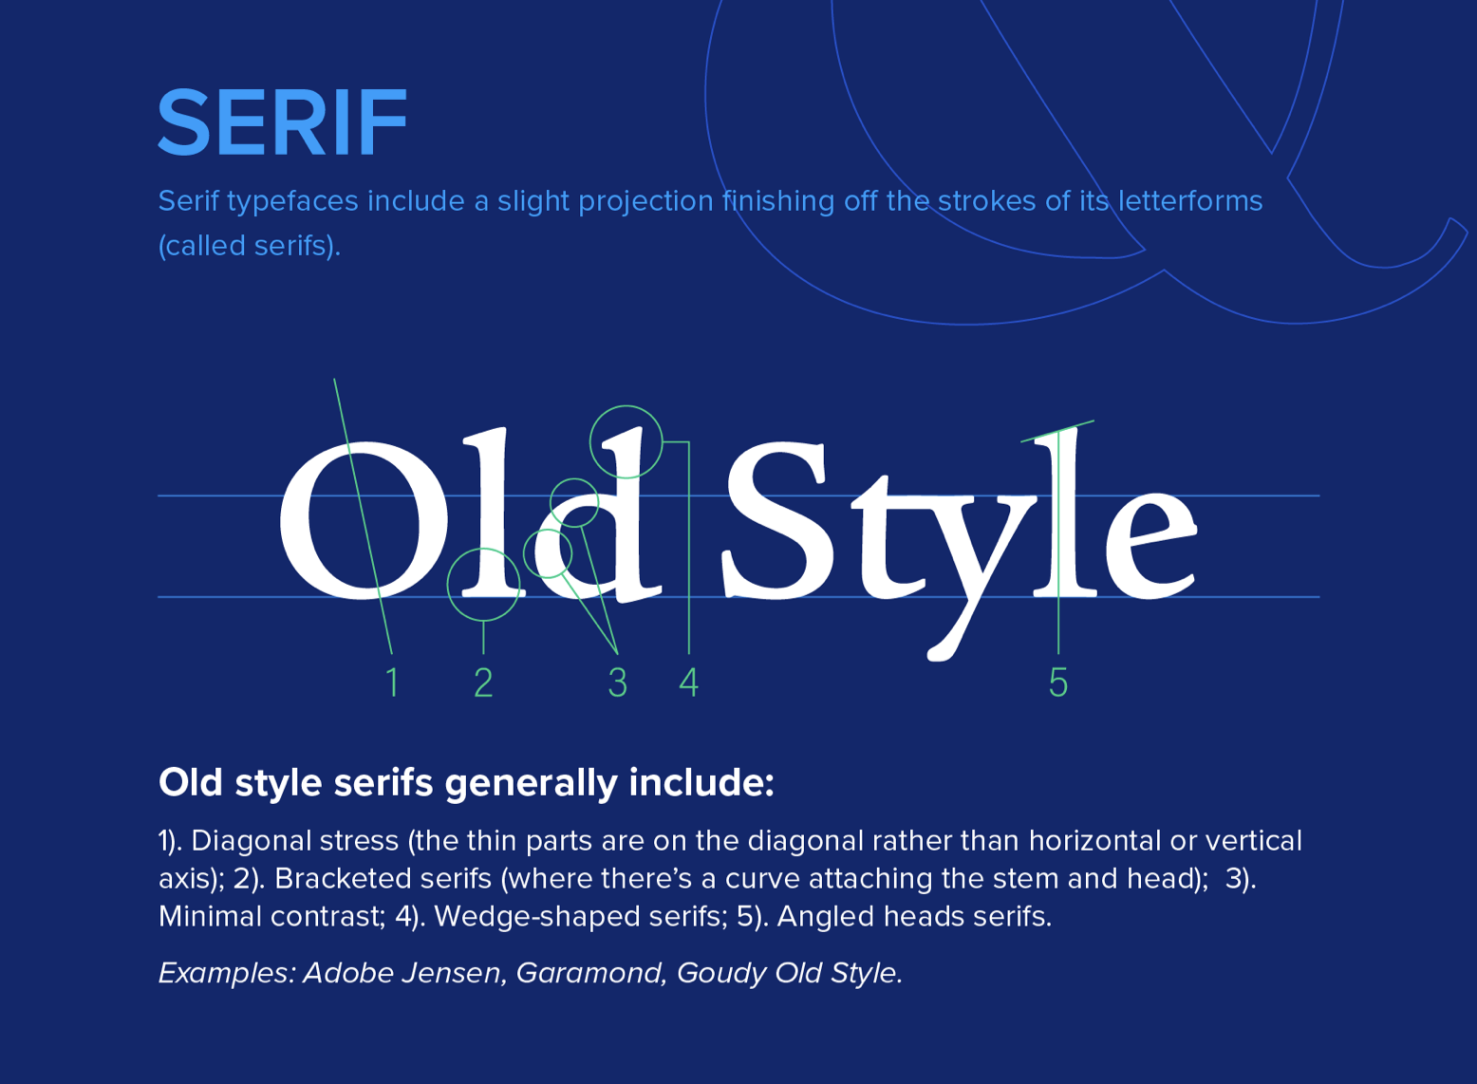
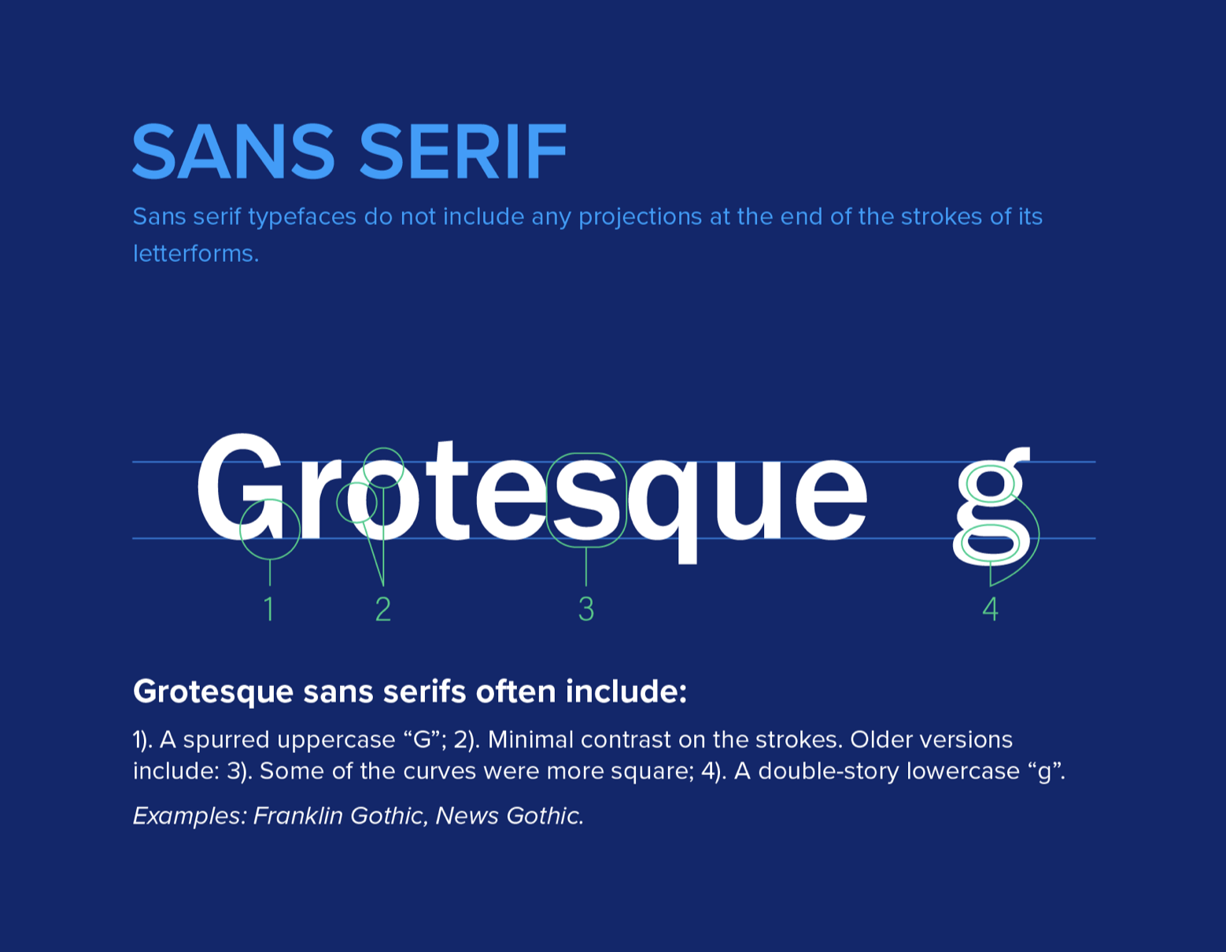
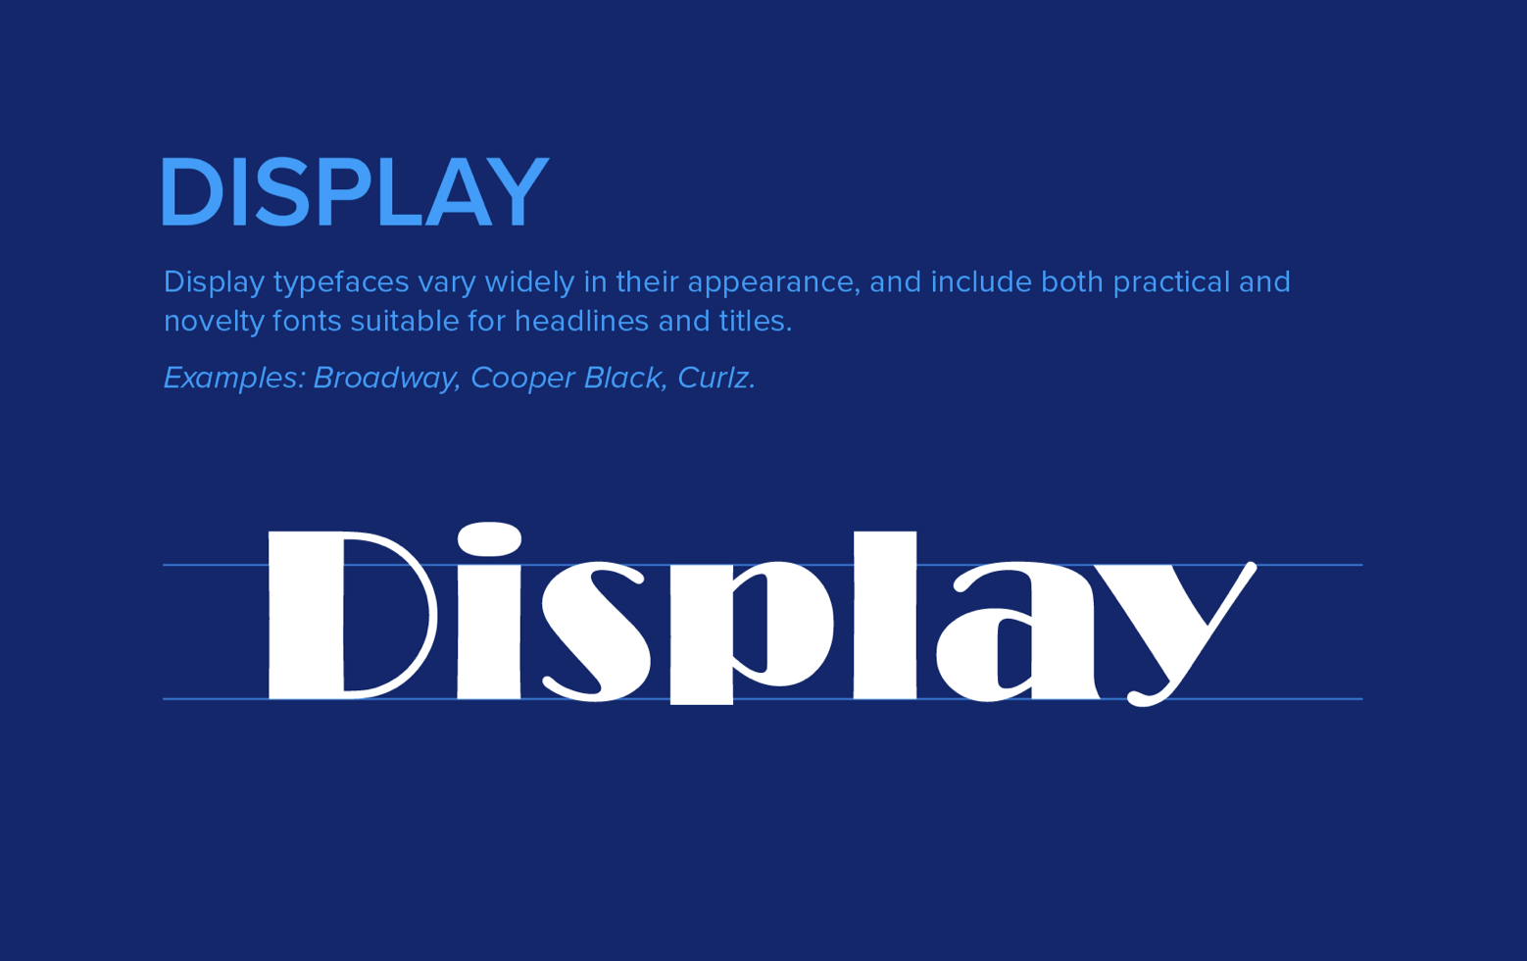
Typography
Categories of type
Serif
A serif is a small shape or projection that appears at the beginning or end of a stroke on a letter. Typefaces with serifs are called serif typefaces.
Sans Serif
A typeface without serifs is called a sans serif typeface, from the French word “sans” that means "without."
Display
A miscellaneous category for all classification types that are only suitable for use at large point sizes. Display fonts typically are used as H1 - H6 in your type scale.
Notes:
If you’ve ever browsed an online library of fonts with hundreds of choices, like Google Fonts, or an independent type foundry’s website with dozens of options, you’ve probably noticed it’s possible to filter according to loose groupings. Commonly, you’ll find groupings such as: Serif, San Serif, Slab Serif, Monospaced, Display etc.
Here we are showing three basic font types Serif, San Serif and Display.

Slide 11
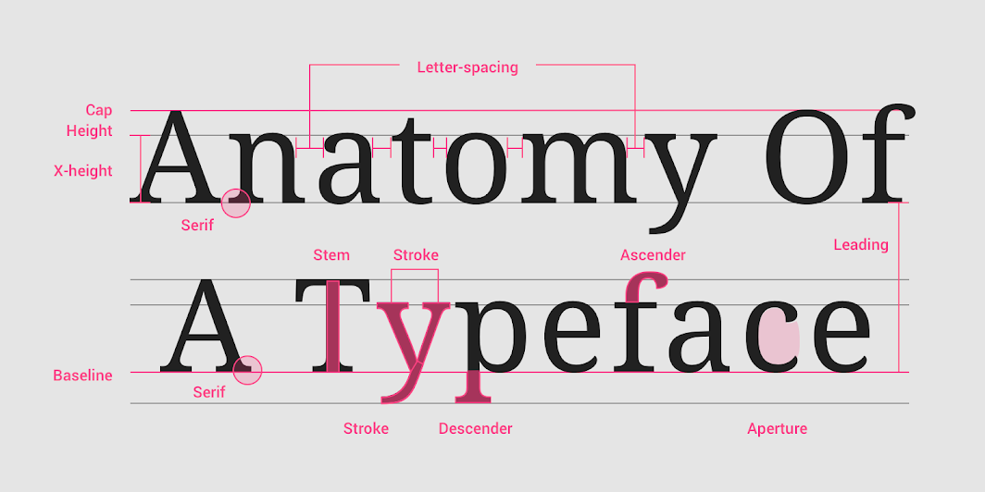
Typography
Typeface properties
Baseline
X height
Weight
Letter spacing/ tracking
Line height / leading
https://material.io/design/typography/understanding-typography.html#type-properties
Notes:
Anatomy of typography
Fonts:
As we all know, a font is a collection of letters and words with the same weights, widths and styles, such as the well-known Times New Roman, Helvetica and Garamond.
Typefaces
However, a typeface is a family of related fonts, like the commonly-used Serif and Sans Serif. So, a typeface often consists of several fonts.
Baseline:
The baseline is the invisible line upon which a line of text rests. In Material Design, the baseline is an important specification in measuring the vertical distance between text and an element.
X height:
X-height refers to the height of the lowercase x for a typeface, and it indicates how tall or short each glyph in a typeface will be.
Typefaces with tall x-heights have better legibility at small font sizes, as the white space within each letter is more legible.
Weight:
Weight refers to the relative thickness of a font’s stroke. A typeface can come in many weights; and four to six weights is a typical number available for a typeface.
Tracking
Letter-spacing, also called tracking, refers to the uniform adjustment of the space between letters in a piece of text. Character spacing: Tracking is overall space between the characters.
Leading:
Line height, also known as leading, controls the amount of space between baselines in a block of text. A text’s line height is proportional to its type size.
Kerning: It’s the space between the specific character. Unlike tracking it varies over the course of the word, because each letter fits together.
Hierarchy
Used to guide reader’s eye to whatever is important

Slide 12
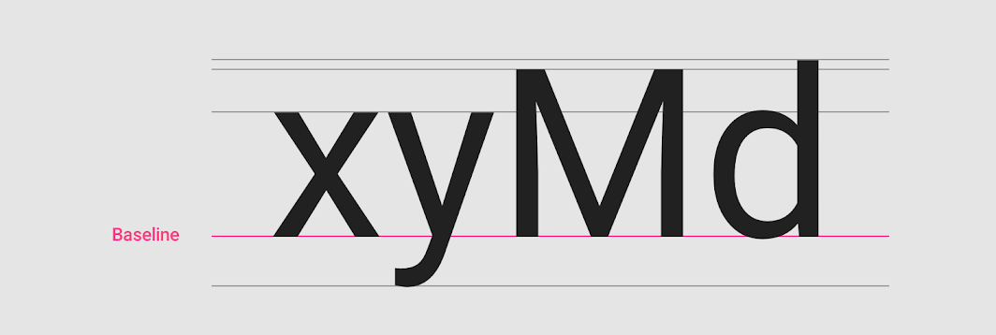
Typography
Baseline
The baseline is the invisible line upon which a line of text rests. In Material Design, the baseline is an important specification in measuring the vertical distance between text and an element.
It’s best used for the 4px grid in Material Design
Image source:https://material.io/design/typography/understanding-typography.html#type-properties
Notes:
The baseline is the invisible line upon which a line of text rests. In Material Design, the baseline is an important specification in measuring the vertical distance between text and an element.
4dp grid
Type aligns to the 4dp baseline grid.
Measurement from the baseline
Specify distances from UI elements from the baseline. Baseline values are software-agnostic, so they work in any design program, and work with the grid. On Android and iOS, code can be translated from baseline-relative specs into padding. For the web, automate the calculation using Sass or CSS.

Slide 13
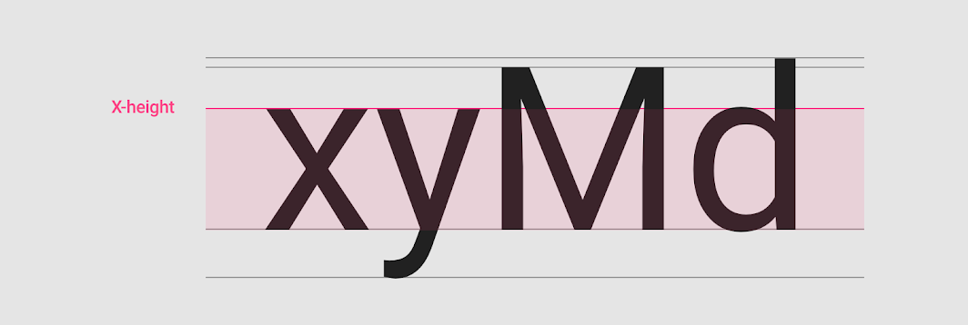
Typography
X-height
X-height refers to the height of the lowercase x for a typeface, and it indicates how tall or short each glyph in a typeface will be.
Typefaces with tall x-heights have better legibility at small font sizes, as the white space within each letter is more legible.
https://material.io/design/typography/understanding-typography.html#type-properties

Slide 14
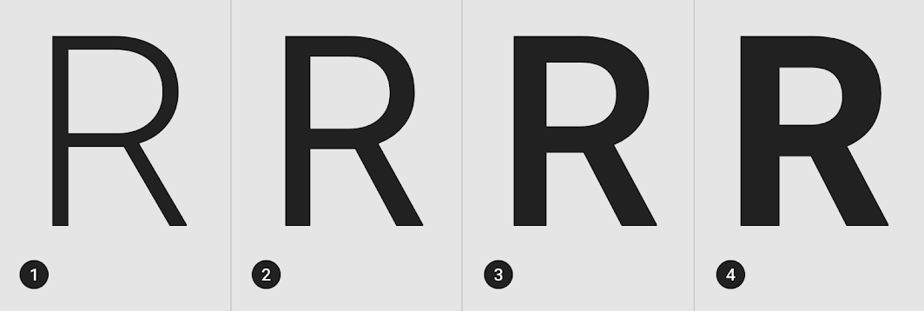
Typography
Font weights
Weight refers to the relative thickness of a font’s stroke. A typeface can come in many weights; and four to six weights is a typical number available for a typeface.
Common weights:
1. Light
2. Regular
3. Medium
4. Bold
https://material.io/design/typography/understanding-typography.html#type-properties

Slide 15
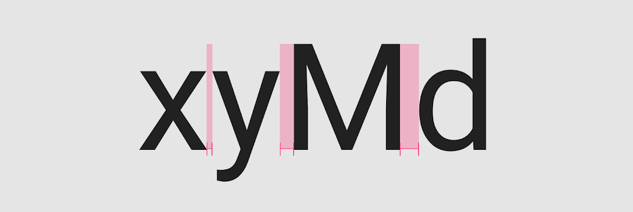
Typography
Tracking
Tracking, also called as letter spacing, refers to the uniform adjustment of the space between letters in a piece of text.
Larger type sizes, such as headlines, use tighter letter spacing to improve readability and reduce space between letters.
For smaller type sizes, looser letter spacing can improve readability as more space between letters increases contrast between each letter shape.
https://material.io/design/typography/understanding-typography.html#type-properties

Slide 16
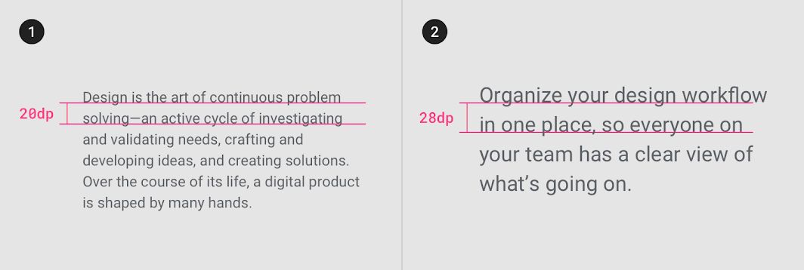
Typography
Leading
Line height, also known as leading, controls the amount of space between baselines in a block of text. A text’s line height is proportional to its type size.
https://material.io/design/typography/understanding-typography.html#type-properties

Slide 17
Typography best practices

Slide 18
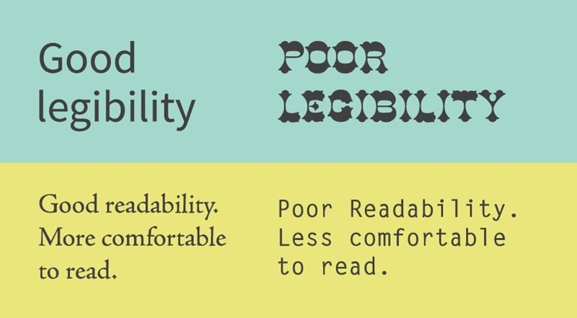
Choose the right typeface and font
Typography
Different typefaces and fonts have their own features, giving users completely different feels. You should always choose the right typeface and font that best suits your design theme and style, delivering the page content in the right mood and tone.
Legibility is the measure of how distinguishable individual characters and words are to the eye of the reader; readability is the measure of how easy it is to read the text overall.
https://pbs.twimg.com/media/DkLnlqOXoAA4ZEn.png

Slide 19
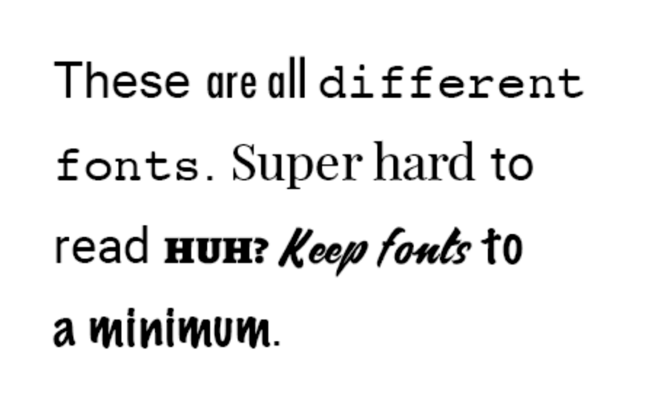
Do not use too many typefaces and fonts
Typography
Keep the number of fonts used to a minimum.
Using more than 3 different fonts makes a website look unstructured and unprofessional.
Keep in mind that too many type sizes and styles at once can also wreck any layout.

Slide 20
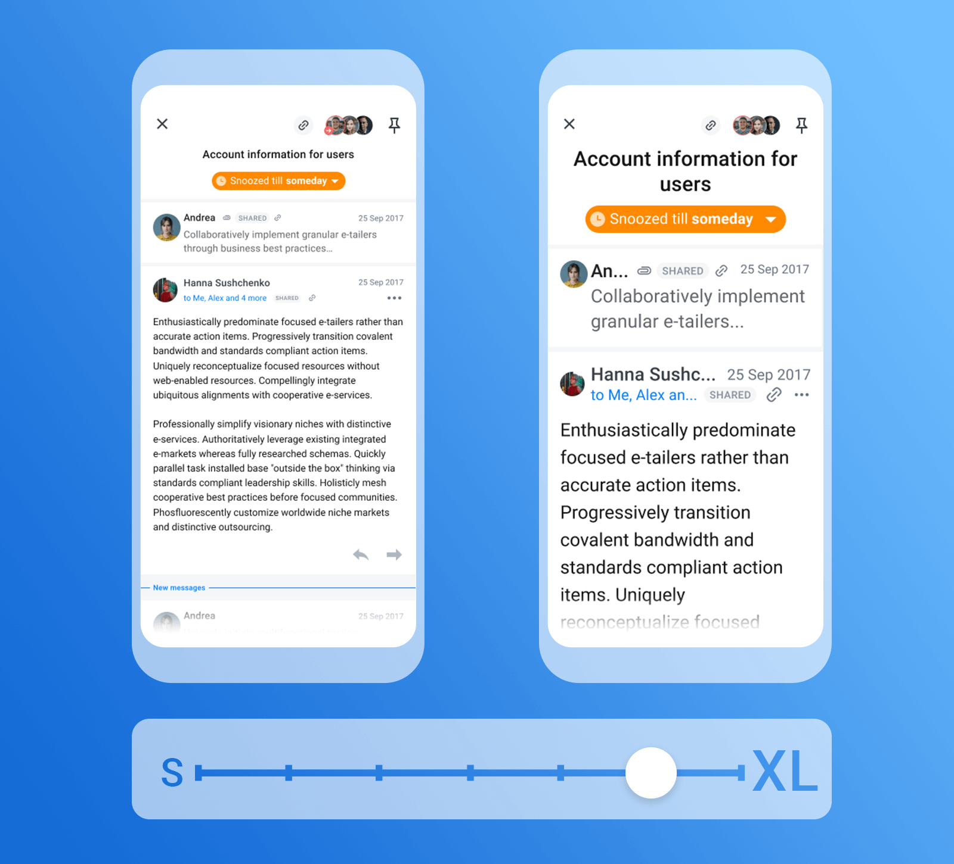
Choose the proper font size
Typography
The size of your text has a huge impact on the experience of reading something on screen.
A general rule of thumb is:
For desktops: Use 16 px font or higher for body text. It’s not too big and it’s comfortable to read.
For iOS devices: Use a text size that’s at least 11 points (it’s legible at a typical viewing distance without zooming).
For Android: Minimal readable font size is 12 sp, but it is highly recommended to use at least 14 sp for the main text.
https://pbs.twimg.com/media/DkLnlqOXoAA4ZEn.png
Notes:
Explain the units for fonts
Px, Pt, Sp
Ref: https://www.w3.org/Style/Examples/007/units.en.html

Slide 21

Create a clear visual hierarchy
Typography
A typography with a great visual hierarchy will also help users find their information fast. So, for better typography design, you should also try to create a clear visual hierarchy. You can use the following elements to create a better visual hierarchy:
A. Headings and titles
B. Space and size
C. Colors

Slide 22
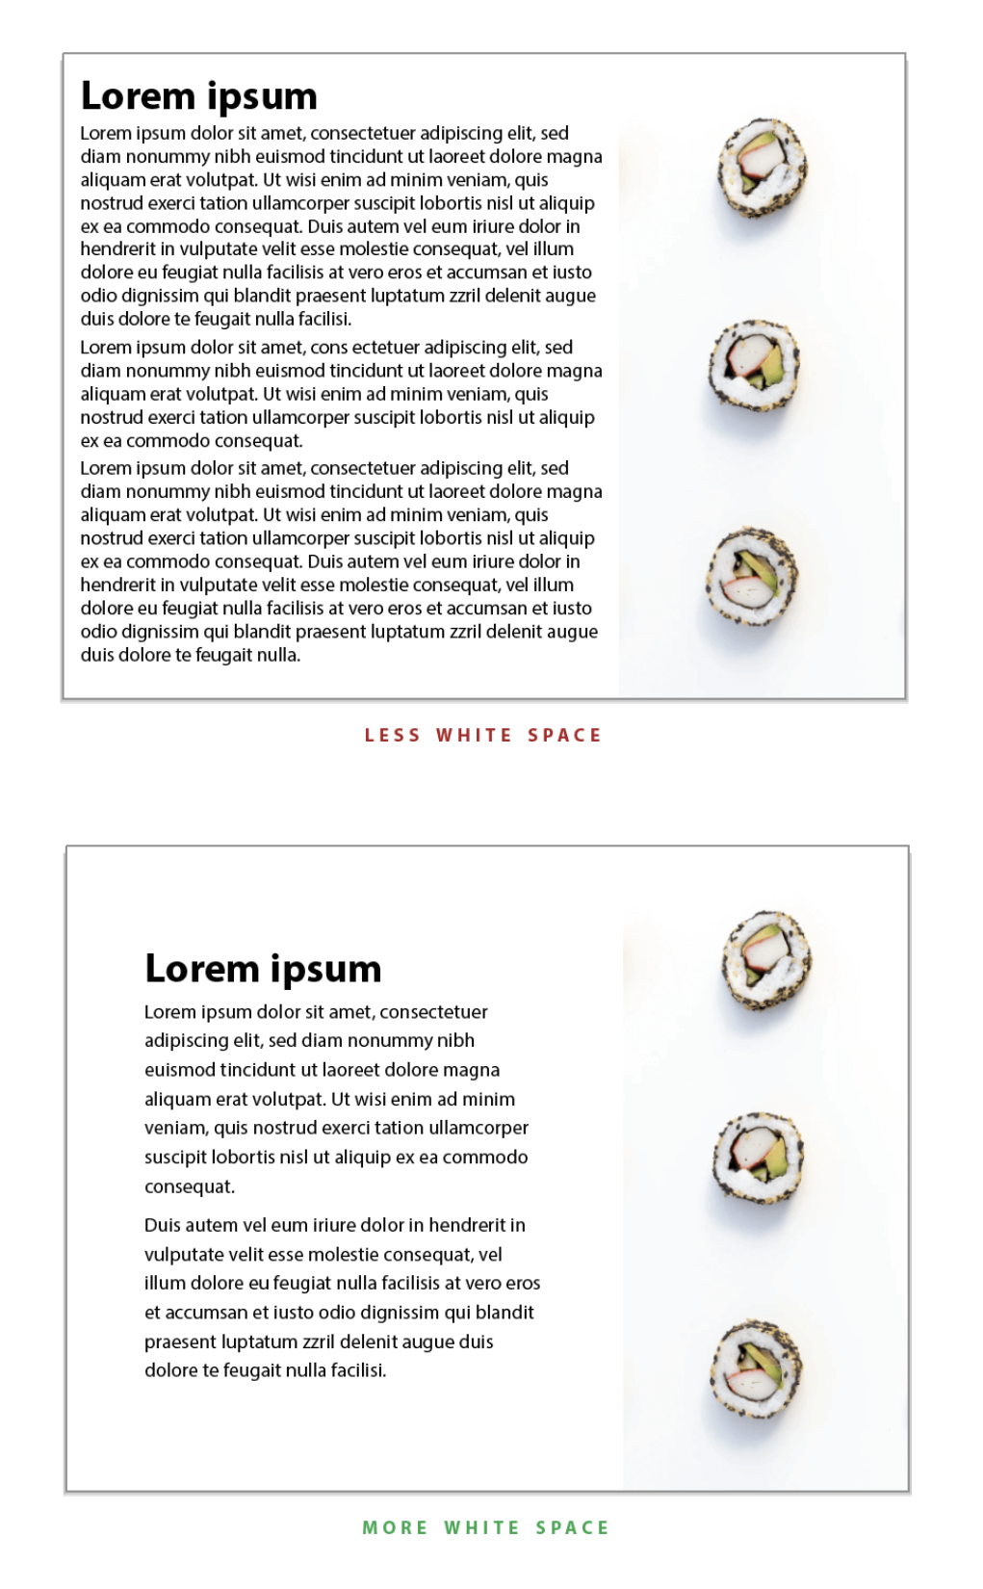
Pay attention to space
Typography
White space This is the empty space between different elements and graphics.
Text space Apart from the space around the elements or block of texts, you should also pay attention to space around the individual text, including the letter and line spacings.

Slide 23
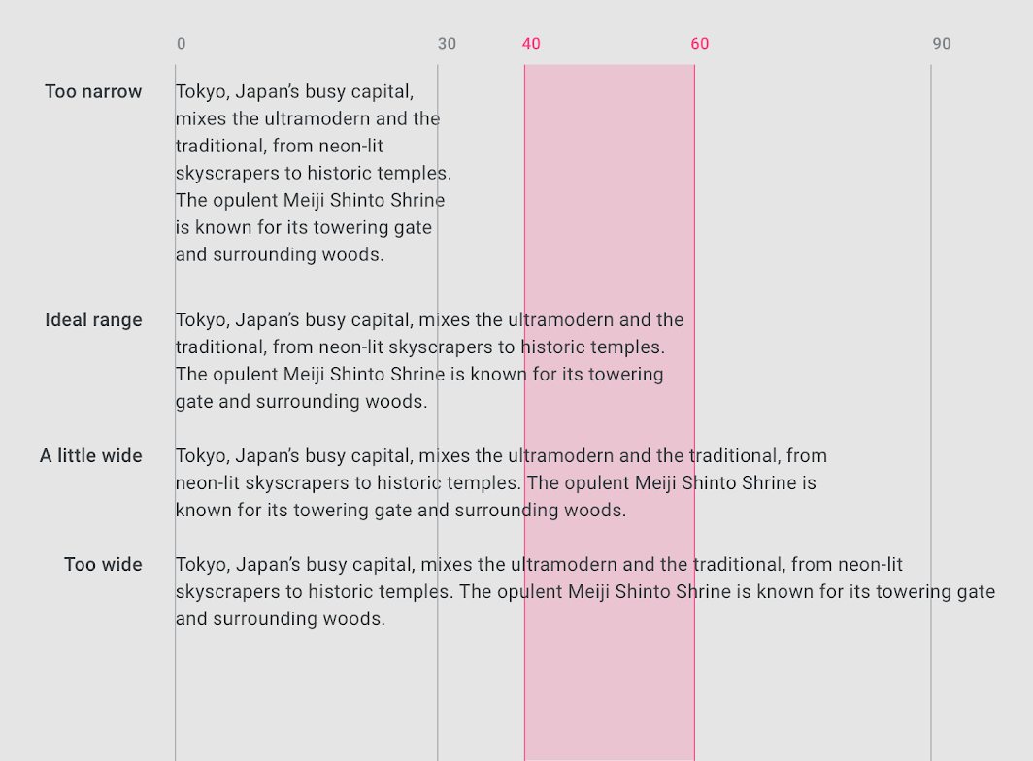
Set the length of the reading distance
Typography
Having the right amount of characters on each line is key to the comfortable reading. The ideal line length for comfortable reading on desktop is around 40 - 60 characters per line, including spaces. This line length has a positive reading rhythm.

Slide 24
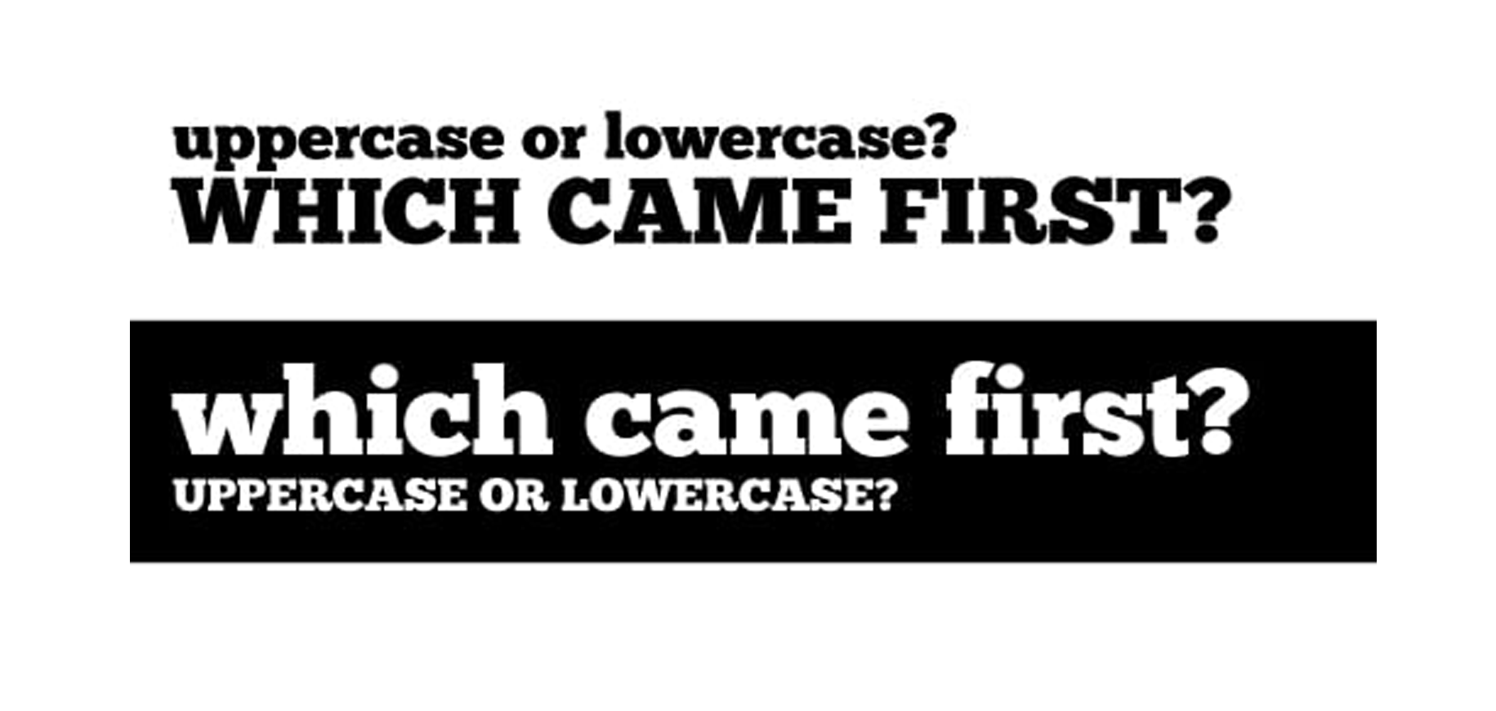
Upper and lowercase combinations
Typography
Using the uppercase and lowercase words together will help you create contrasts to effectively convey desired interface messages.
https://tomweb.sk/tag/headline/

Slide 25
Advantages of good typography in UI

Slide 26
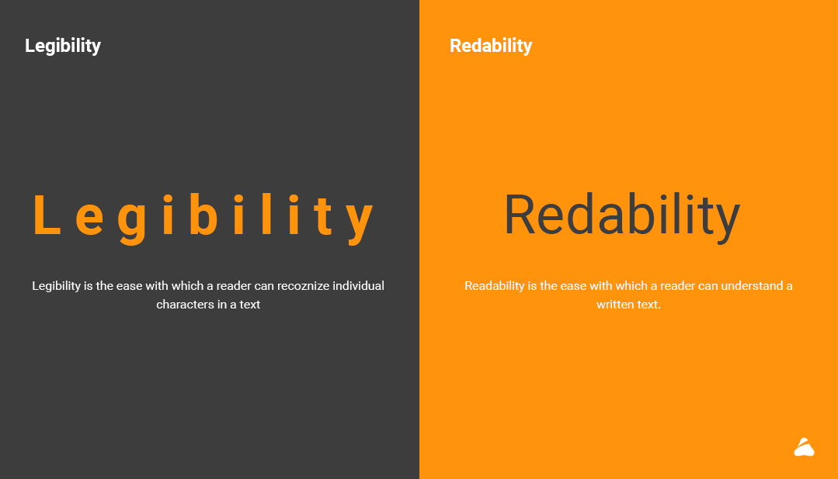
Enhances UI readability, legibility and accessibility
Typography
Typography in UI design works just like a visual communication tool to engage users and convince them to stay longer or buy something.
When users visit a website or mobile app, instead of reading texts line by line, they often first scan the entire page to see whether there is data they need. At this moment, a scannable and well-organized typography will impress and engage potential customers or users.
https://pbs.twimg.com/media/DkLnlqOXoAA4ZEn.png
Notes:
Although both terms are related, legibility is the measure of how distinguishable individual characters and words are to the eye of the reader; readability is the measure of how easy it is to read the text overall. Both are measures of clarity.

Slide 27
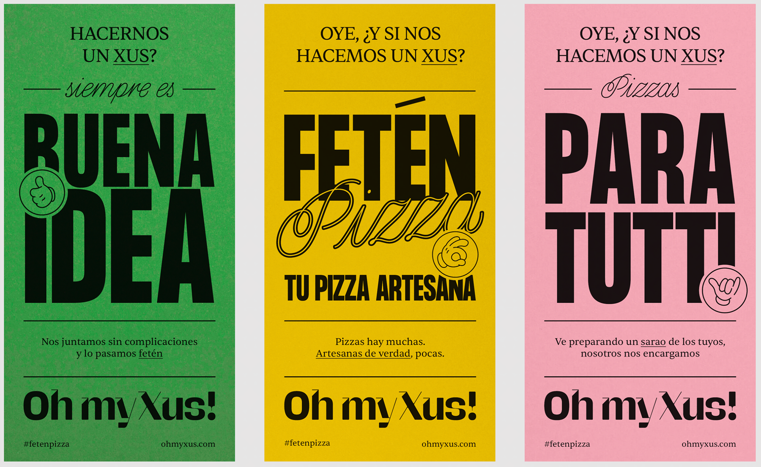
Sets a consistent tone and mood
Typography
The style of typography also sets an overall tone or mood for all interfaces.
Notes:
For example, when you are using a cartoon font with warm colors, you add fun to your page. However, when you choose a plain and simple typography, you seem to set a serious tone for your entire app.

Slide 28
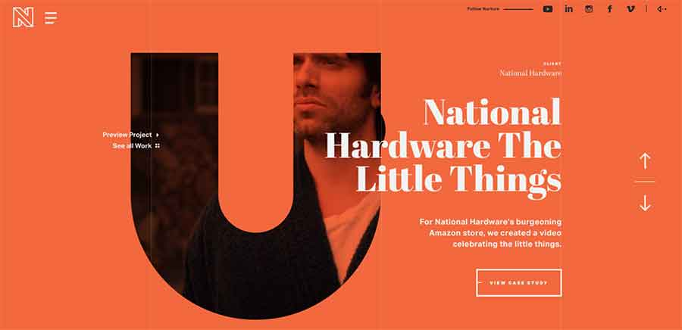
Makes your UI stand out from others
Typography
Like other elements in UI design, high-quality typography often gives a professional look, and resonates the brand vision. Unique and effective typography also impresses users
https://pbs.twimg.com/media/DkLnlqOXoAA4ZEn.png

Slide 29
Typography
Typography focused designs

Slide 30
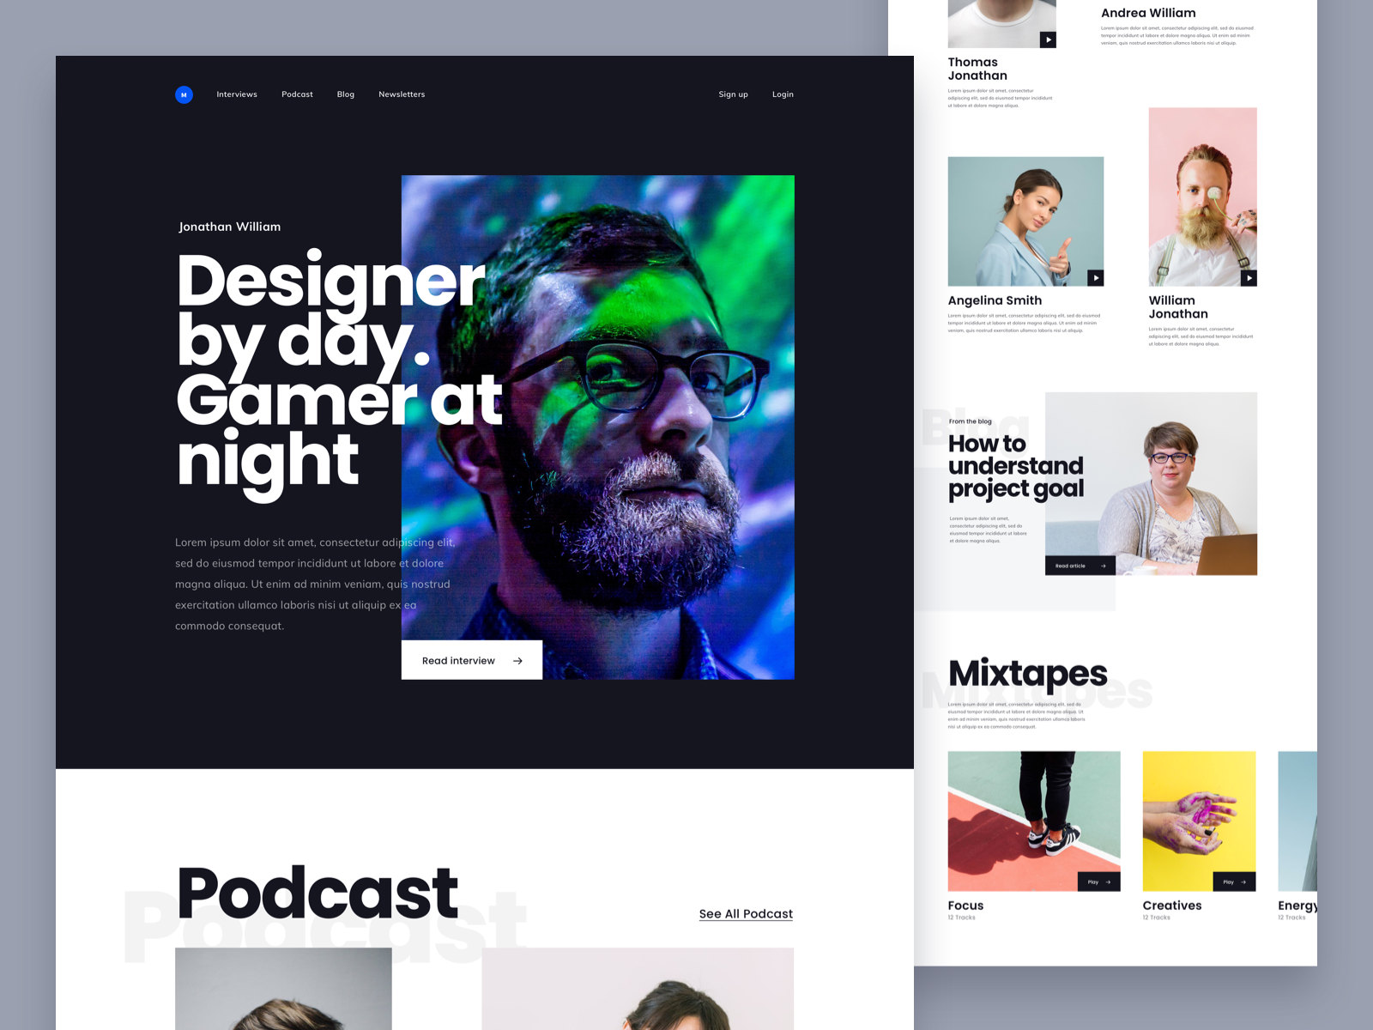
Notes:
Explain how typography helps to define the character of the design.

Slide 31
Notes:
Explain how typography helps to define the character of the design.

Slide 32
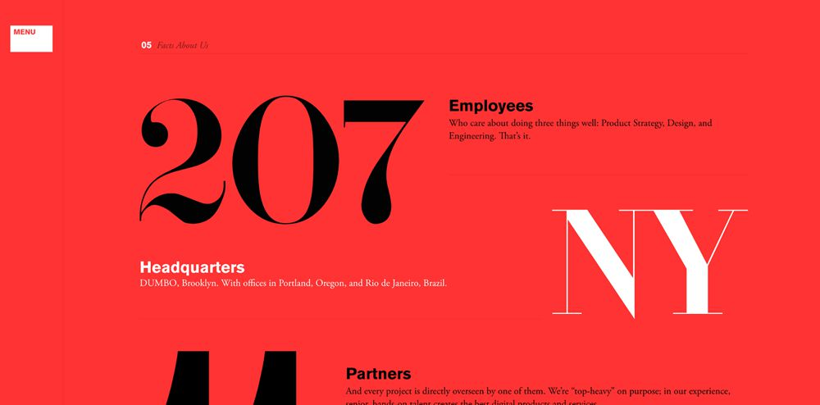
Notes:
Explain how typography helps to define the character of the design.

Slide 33
Typography and design system

Slide 34
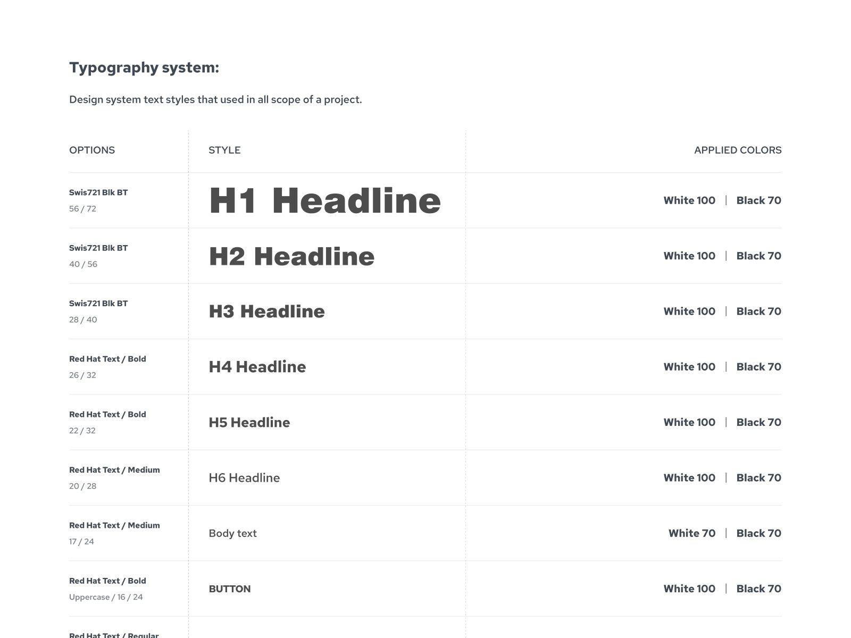
Typography
Defining the hierarchy is key
As a general rule, every design should include three levels of hierarchy: heading, subheading, and body text.
Additional levels are the prerogative of the designer.
Notes:
One of the first things to consider is how many levels of hierarchy a design should have. From there, it’s up to the designer to consider additional levels that might be necessary. These could include captions, additional subheadings, pull quotes, and meta information

Slide 35
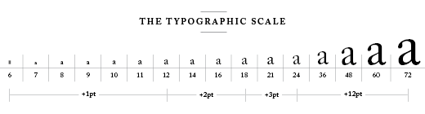
Typography
Use of typographic scale
Traditional typographic scales exist to help designers get started. But these are only a starting point, and designers should feel free to experiment with different weights and styles while deviating from these traditional scales
http://retinart.net/typography/typographicscale/
Notes:
Ref: https://retinart.net/typography/typographicscale/
A list of numbers that make it easier to set type. But why these numbers?
The scale is more of a guide. A way of saying ‘if you stick with these sizes you’re given a hint to develop beautiful typography’.
The typographic scale is the bedrock of modern typography, used for centuries to choose harmonious font sizes.

Slide 36
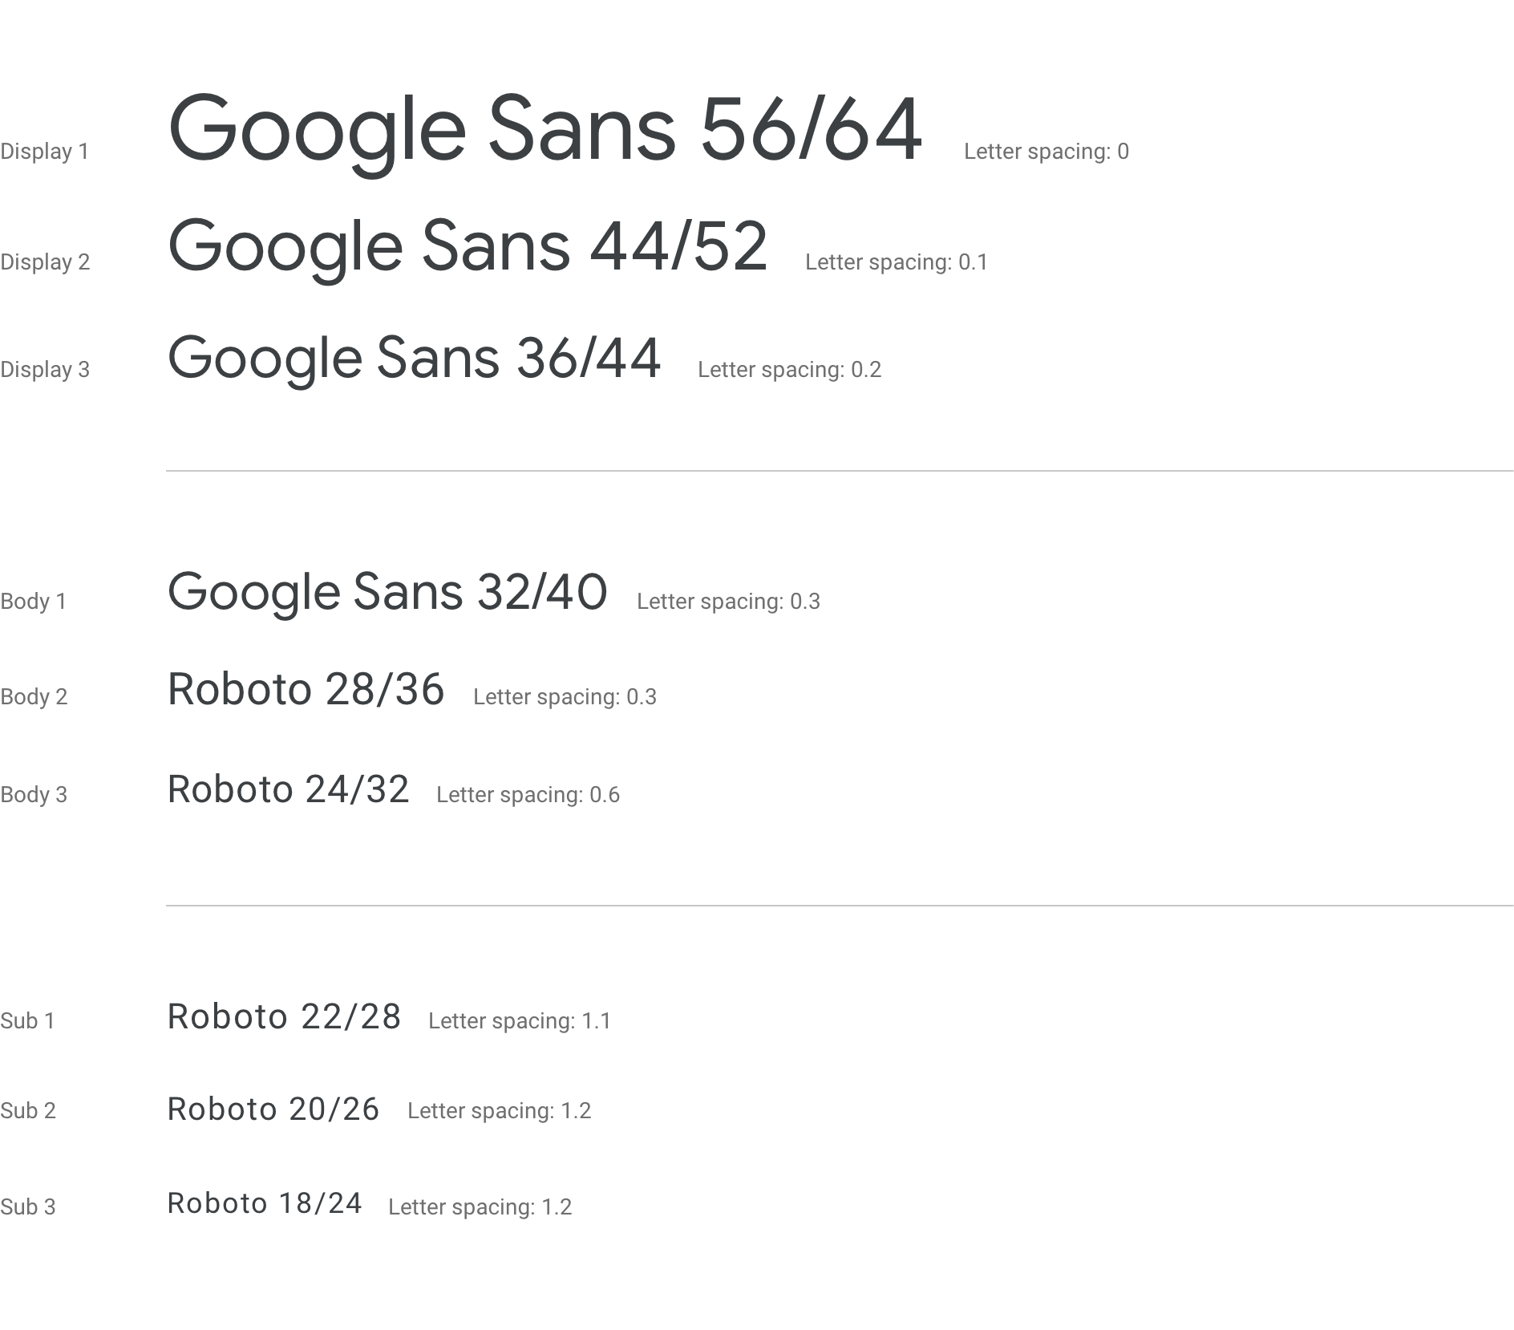
Typography
Determine line height for all scales
Font sizes and line-heights are closely related, and are usually influenced by or will influence, some of the underlying grids used in your design.
A line-height of 1.5x font size is a general rule of thumb as a starting point. Many designers will use line-height as a foundation to establish an underlying baseline grid to which all sizes are mapped to or divide equally into.
http://retinart.net/typography/typographicscale/
Notes:
Source: https://www.designsystems.com/typography-guides/

Slide 37
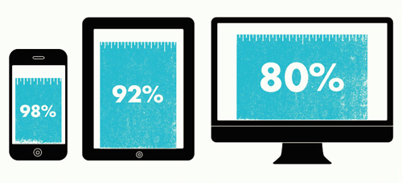
Typography
Define typography for different view ports
Typography needs to be scalable for different view ports.
A web page going from desktop to tablet and then to mobile view port needs harmony in the typography.
Usually, responsive typography takes care of that but defining rules for different viewports becomes necessary.
https://www.smashingmagazine.com/2016/05/fluid-typography/

Slide 38
Typography
Typography design system examples

Slide 39
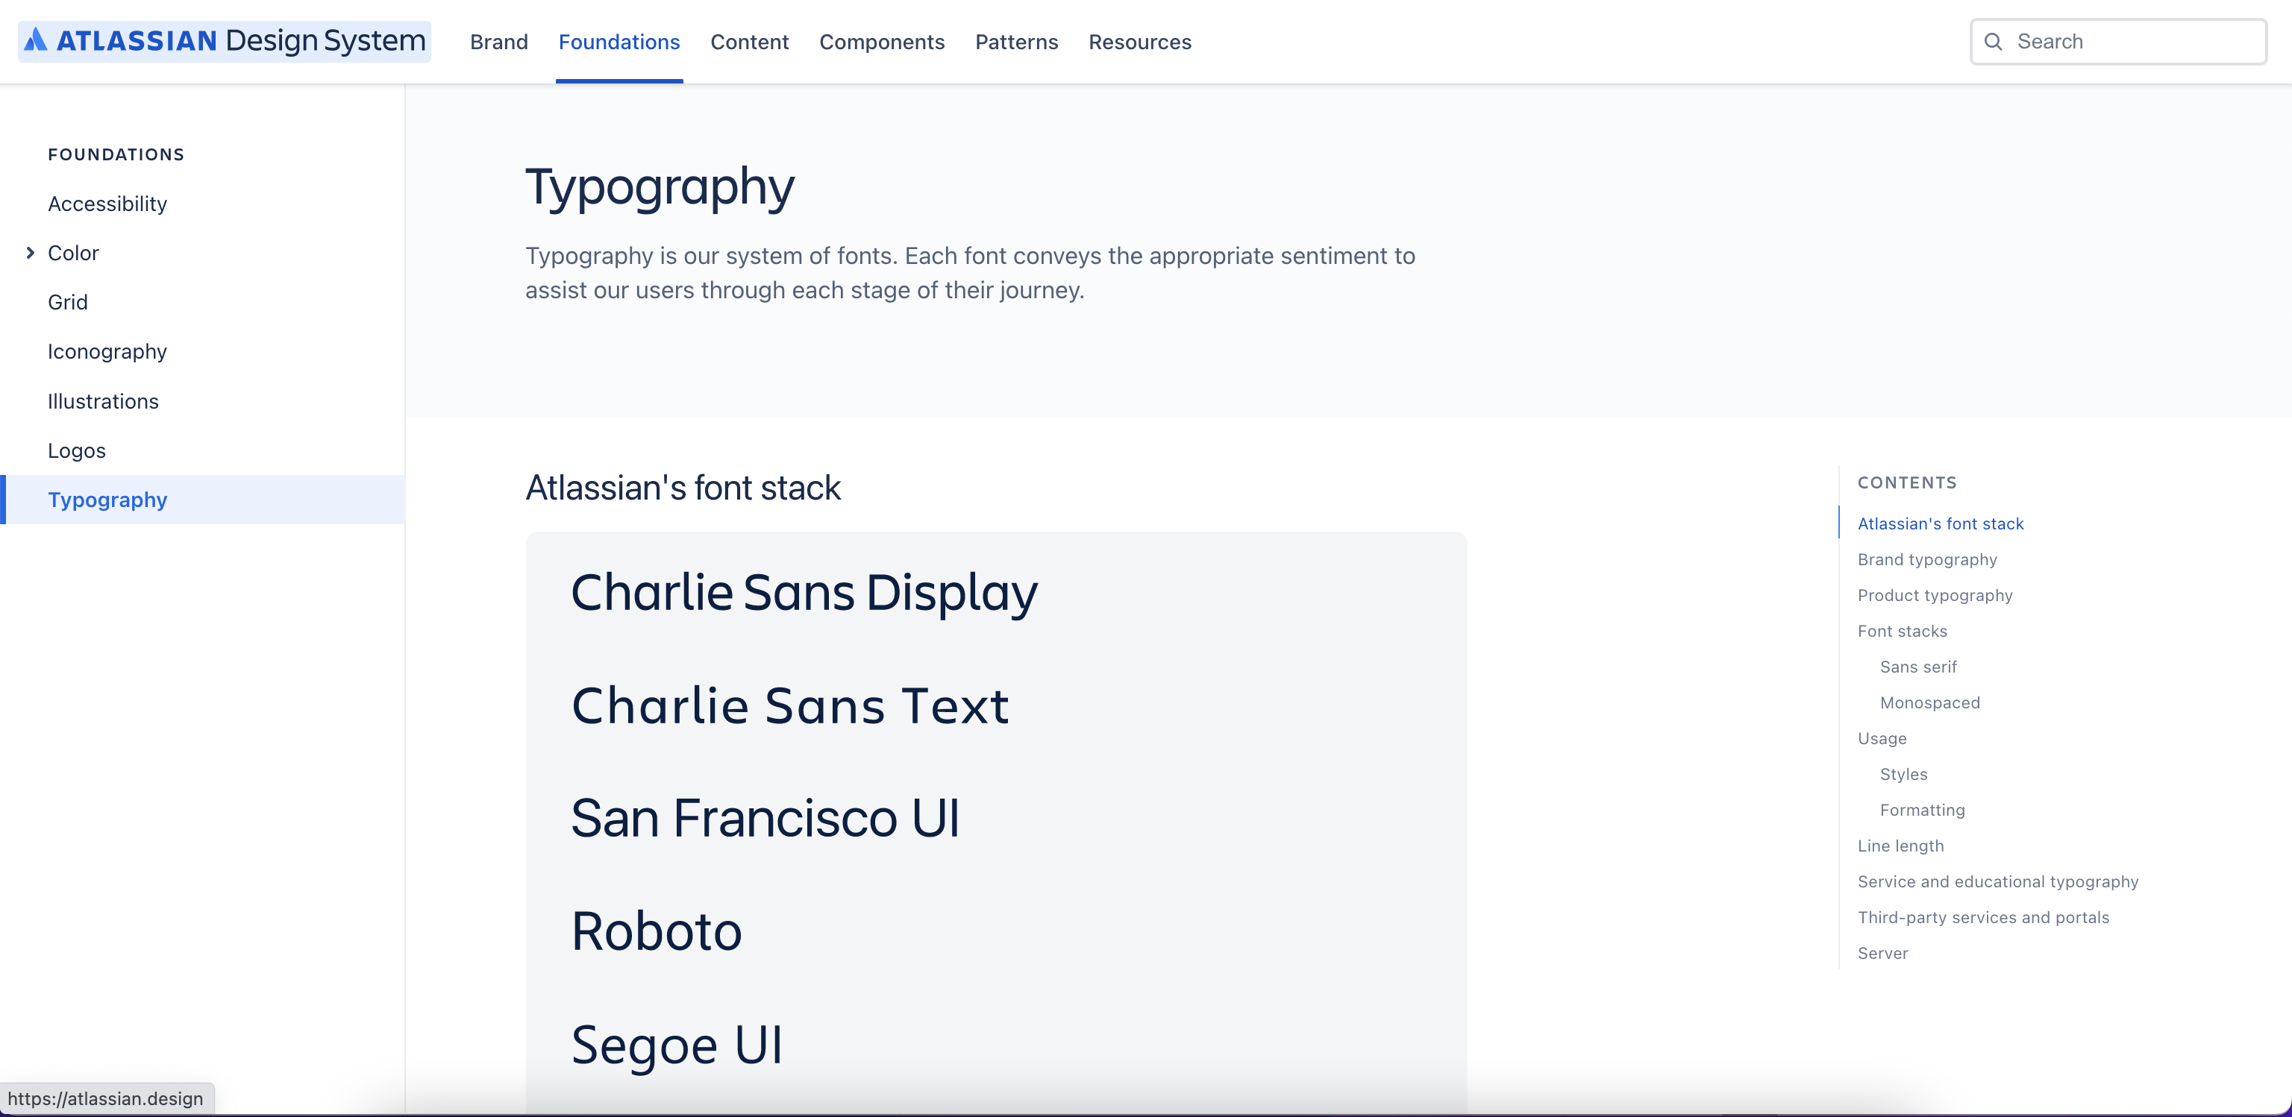
Typography
A few examples of good typography
Atlassian design

Slide 40
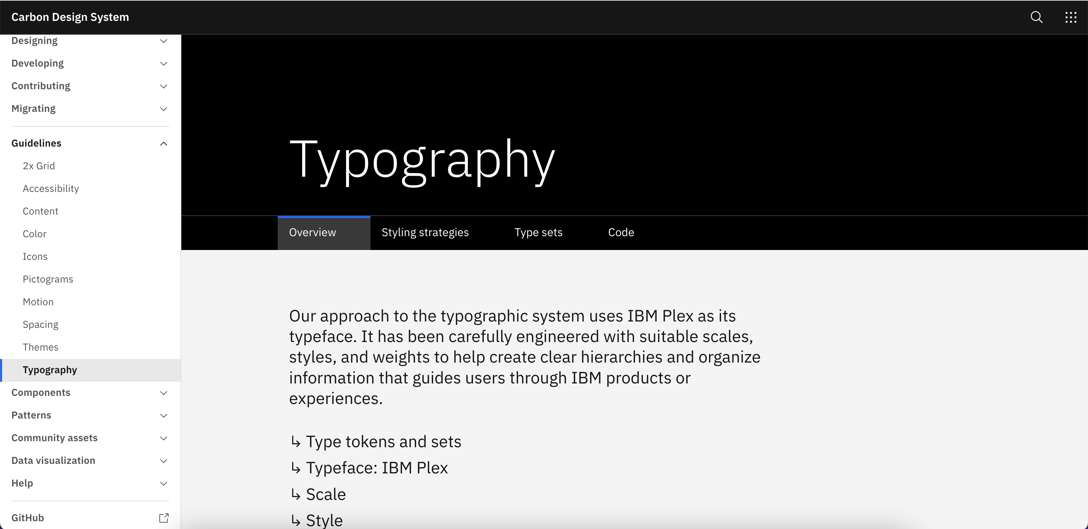
Typography
A few examples of good typography
IBM’s Carbon design system

Slide 41
To wrap up,
Typography
Typography is the decision we make with how type is applied to written language to offer a comfortable reading experience and a stylistic expression.
Multiple aspects of typography like readability, legibility, use of font, maximum reading length, etc. are important to define a robust typography.
Typography plays a major role in Design Systems. It’s one of the important aspect of brand’s look and feel and also defines the personality and characteristics.

Slide 42
Information sources
Typography
https://material.io/design/typography/understanding-typography.html#type-properties
https://www.mockplus.com/blog/post/typography-design-guide
https://www.toptal.com/designers/typography/typographic-hierarchy
https://www.designsystems.com/typography-guides/

Slide 43
Thank you!

